Slide 1

Presentation Title
Ignite-style talks are intended as timely, provocative, conversation-starting, and creative five-minute talk addressing a hot topic in informatics.
Ignite Format Rules:
1. Your Ignite talk will contain exactly 20 slides, 15 seconds each, automatically advanced
2. Please use *this* AMIA Ignite PowerPoint slide template provided by AMIA.
3. After your presentation, a moderator will facilitate brief dialogue with the audience and move to the next presentation.
For samples of both how to give an Ignite talk and for examples see:
https://www.youtube.com/watch?v=rRa1IPkBFbg
https://www.youtube.com/watch?v=bGYgFYG2Ccw
https://www.youtube.com/watch?v=QYyJZOHgpco

Slide 2

Header

Slide 3
Header

Slide 4
Header

Slide 5
Header

Slide 6

Header

Slide 7
Header

Slide 8
Header

Slide 9
Header

Slide 10
Header

Slide 11

Header

Slide 12
Header

Slide 13
Header

Slide 14
Header

Slide 15
Header

Slide 16
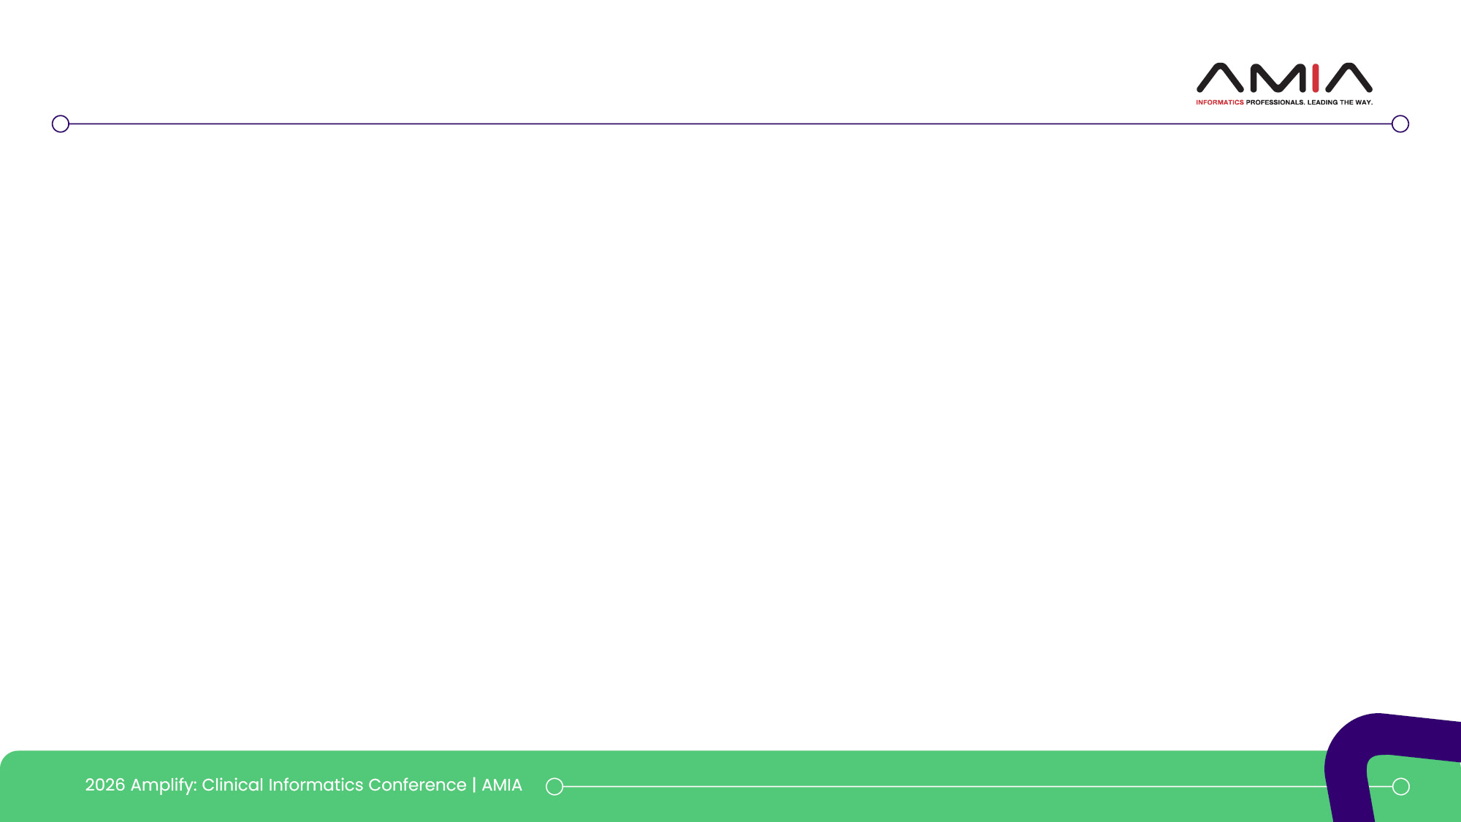
Header

Slide 17
Header

Slide 18
Header

Slide 19
Header

Slide 20
Header

