Slide 1

TrendBurden: Pulse Survey on Excessive Documentation Burden for Health Professionals©
Strachna, O.; Boventer, E.; Wolski, P.; Mishra, A.; AMIA 25x5 Task Force. TrendBurden: Pulse Survey on Excessive Documentation Burden for Health Professionals© Database (versions 1.0, 1.1, 2.0, 2.1). AMIA.org 2025.
Acknowledgments:
The development of the TrendBurden Survey was made possible through the collaborative efforts of the following contributors, whose expertise and commitment were instrumental in shaping the tool: E. A. Sloss, A. Owoyemi, A. K. Mishra, K. Sidwell, S. Abdul, G. Dawood, M. Allen, D. Austria, Z. Pope, F. Chekeni, S. Corley, A. Grigg, V. Hartman, K. B. Johnson, D. R. Levy, K. Marshall, J. Murphy, B. Newman, T. Phillips, K. Smith, J. Szymanski, and S. Rossetti.
We acknowledge the AMIA 25x5 Impact Workstream for their guidance and continued support in administering and maintaining the TrendBurden Survey.

Slide 2
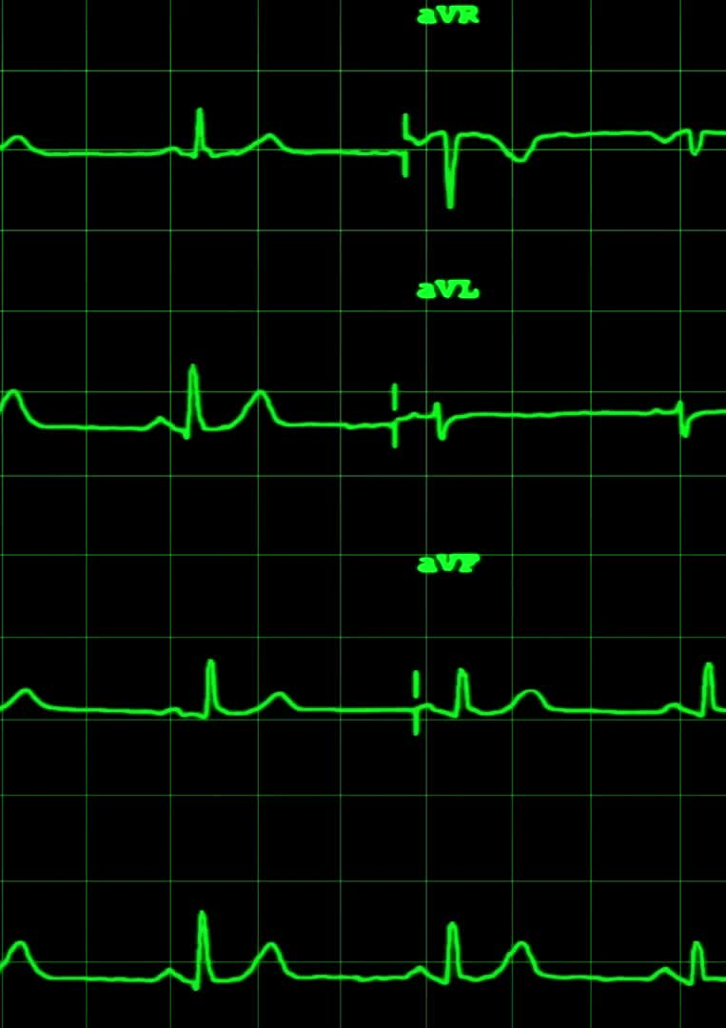
TrendBurden: Pulse Survey
April 2024 – 1,253 responses
September 2024 – 706 responses
April 2025 – 515 responses
September 2025 – 345 responses
Biannual survey to track and trend changes over time
Demographics available: Gender, Age, Years of Experience, Clinical Role, Region
Notes:
Biannual pulse survey targeting all patient-facing health professionals
5 questions + some demographic questions
Completed 4 rounds so far
Decreasing response rate

Slide 3





TrendBurden: Pulse Survey
Question | 1 | 2 | 3 | 4 | 5
Q1. The amount of time and effort I spend documenting patient care is appropriate. | Strongly Disagree | Disagree | Neither agree nor disagree | Agree | Strongly Agree
Q2. I finish work later than desired or need to do work at home because of excessive documentation tasks. | Strongly Agree | Agree | Neither agree nor disagree | Disagree | Strongly Disagree
Q3. In the past 6 months, there has been a noticeable change in the time or effort or both needed for me to complete my documentation tasks. | Greatly increased | Somewhat increased | Unchanged | Somewhat decreased | Greatly decreased
Q4. The effort or time required for me to complete documentation tasks impedes patient care. | Strongly Agree | Agree | Neither agree nor disagree | Disagree | Strongly Disagree
Q5. I find it easy to document patient care using the electronic health record. | Strongly Disagree | Disagree | Neither agree nor disagree | Agree | Strongly Agree
Reverse scoring performed for questions 2 and 4 so that higher scores correlate with more positive responses. Demographic categories with fewer than 20 participants were excluded from the analysis
Notes:
Reminder: these are the 5 questions
Note we did reverse coding on question 2 and 4 where we flipped the likert scale so that a 5 is strongly disagree
Did this for consistency and easier interpretation so that a higher score always correlates to a more positive outcome or experience

Slide 4
Notes:
Overall responses for the 5 questions across the 4 rounds
Score of 3 is neutral – across the board (with exception of Q5) perceptions still more negative with average scores of <3
Haven’t statistical significance testing – but looks like there may be a positive trend though with sample size (n) of the most recent round being ¼ of the first round, the confidence intervals are widening

Slide 5
Notes:
Another visualization showing the percentage of respondents for each answer over the 4 rounds
Looks like maybe some slight improvements in perception of time and effort spent, working late, impeding patient care (Q1, 2, 5)– the most noticeable improvement is whether respondents find it easy to document (Q5)
The one area that we don’t really see much change is for Q3 which asks if respondents have noticed an increase or decrease in documentation burden – they’re still mostly not noticing any difference.

Slide 6
Notes:
For sub analyses – we looked at responses by clinical role: physicians, nurses, advanced care providers and all other roles
Once again haven’t done significance testing but looks like some trends we’re seeing are that:
Q2 (Working late or at home): RNs responses about having to finish work at home continues to be more positive (they disagree with that statement more) than physicians/APPs which makes sense
Q3 (noticeable change): Physicians still more positive than other groups about whether they notice a positive vs negative change – though in this case more that they haven’t noticed a change as opposed a decrease in documentation burden
Q5: (easy to document): RNs are more likely to endorse that they find it easy to document compared to other groups, especially physicians

Slide 7
Notes:
For comparison of male vs female respondents:
- Seem to be pretty comparable with maybe female respondents on average more often saying they’ve noticed an increase in docburden (Q3) but also more saying they’re finding it easy to document (Q5, also >3 so they’re saying they agree with the statement that they find it easy to document)

Slide 8
Notes:
When comparing groups by years of experience – don’t really see any distinction between groups.

Slide 9
Notes:
Same with by age group – all seem pretty similar without an obvious difference in trends.

Slide 10
Notes:
When comparing by region: Midwest, northeast, south and west:
- Previously noted for question 1 (time and effort spent documenting is appropriate) that maybe Midwest respondents are more positive, don’t really see that in the most recent round so would also say we’re not noticing any obvious differences by region.

